Slide 1
3 – EF Model First

Slide 2
Modeling issues
Relationships
Splitting
Inheritance
Sub-type per-table with filter
Table per type
Table per hierarchy
Enums
Keys / identity

Slide 3
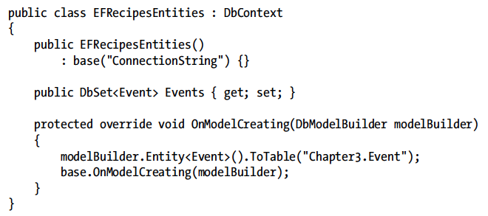
Model creating / mapping

Slide 4
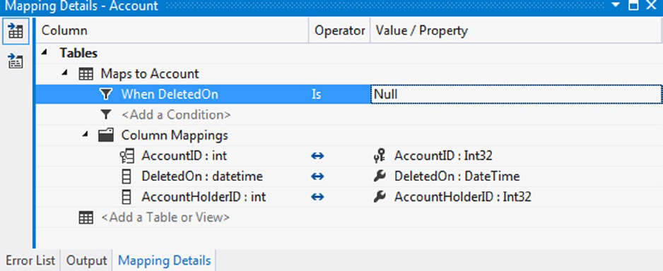
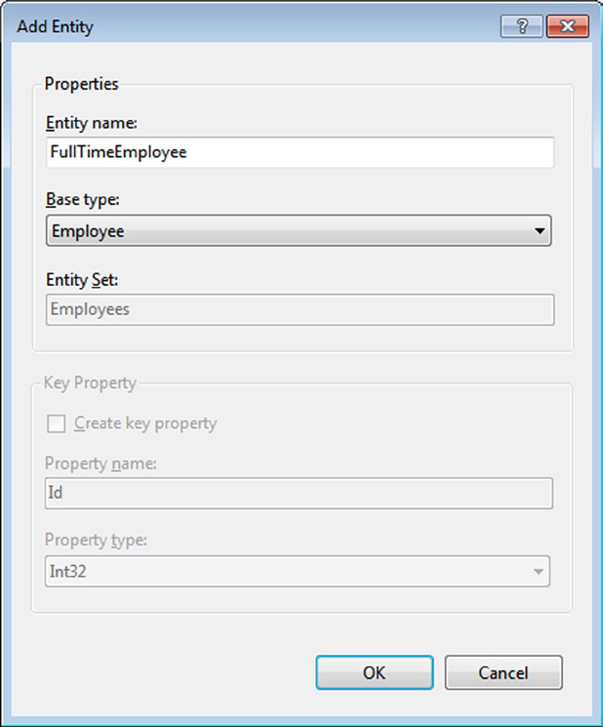
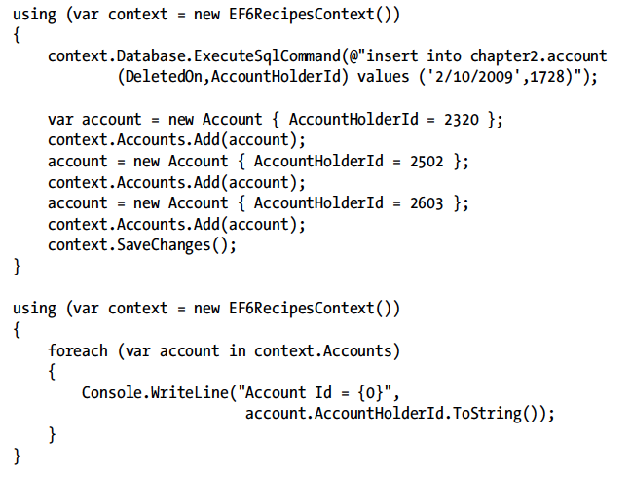
Sub-type filter

Slide 5
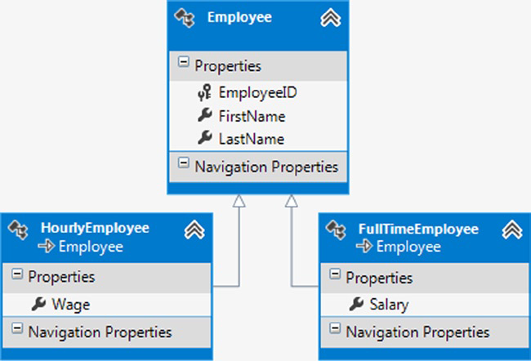
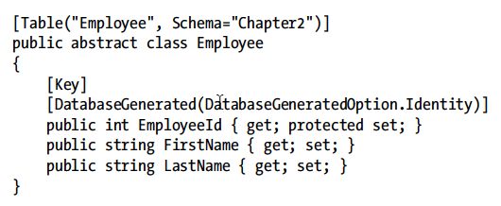
Table per hierarchy

Slide 6
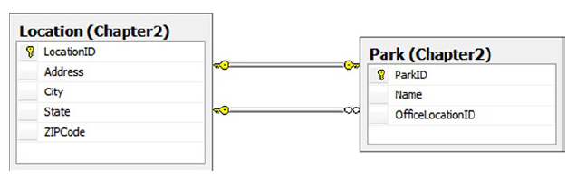
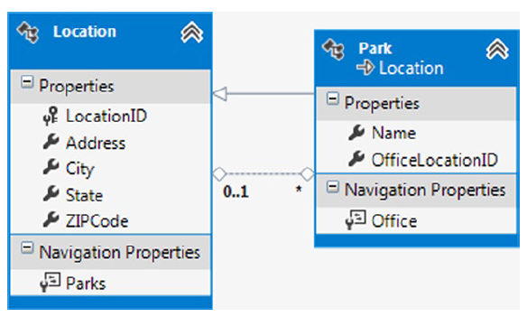
Is-a has-a

Slide 7
Demo

Slide 8
Summary

